Slide 1

NSF-BSF Collaborative Research in the Biological Sciences
Matthew D. Kane
Program Director
Division of Environmental Biology
National Science Foundation
September, 2017

Slide 2


U.S. President
Office of
Management
and Budget
Science Advisor
Other boards,
councils, etc.
Office of Science and
Technology Policy
Science Advisor
Major Departments
Agriculture
Health and
Human Services
Interior
Transportation
Defense
Energy
Commerce
Independent Agencies
National
Aeronautic
and Space
Administration
Environmental
Protection
Agency
Smithsonian
Institution
Nuclear
Regulatory
Commission
Other
agencies

Slide 3

National Science Board
Office of Inspector General
National Science Foundation
Director Deputy Director
Office of the Director
Legislative & Public Affairs
General Counsel
International and Integrative Activities
Directorates
Biological Sciences
Comp. & Info. Science & Engineering
Education & Human Resources
Engineering
Geosciences (inlcudes Polar)
Mathematical & Physical Sciences
Social, Behaviorial & Econ. Sciences
Offices
Budget, Finance & Award Management
Information & Resource Management

Slide 4


NSF Mission (from 1950 Act)
To promote the progress of science; to advance the national health, prosperity, and welfare; and to secure the national defense; and for all other purposes.
NSF Vision
[to enable the USA to become a] nation that creates and exploits new concepts in science and engineering and provides global leadership in research and education.
Core Values
Scientific Excellence
Organizational Excellence
Learning
Inclusiveness
Accountability for Public Benefit
Strategic Goals
Transform the frontiers of science and engineering
Stimulate innovation and address societal needs through research and education
Excel as a Federal Science Agency
Source: NSF Strategic Plan for 2014-2018; available at http://www.nsf.gov/pubs/2014/nsf14043/nsf14043.pdf

Slide 5
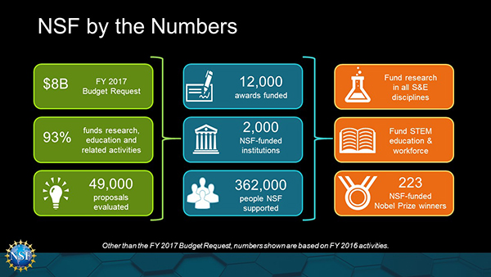

Slide 6
NSF is unique among federal RESearch funding agencies
Mandate to fund both research and education
Focus on basic research in all areas of science
All areas of science, engineering and computer science are housed in one agency
Funding decisions based on advisory peer review to program directors who have discretion to set direction/ balance portfolio

Slide 7





Where Does NSF Fit?
Basic
Translation
(NIH, USDA,DOE etc)
Utility
US PIs and ISRAELI COLLABORATORs SHOULD TALK TO NSF PROGRAM DIRECTORS WITH ANY QUESTIONS

Slide 8
NSF-BSF Dear Colleague letter (DCL)
There is one Dear Colleague Letter (NSF 17-120) & set of instructions that apply to all of NSF:
  https://www.nsf.gov/pubs/2017/nsf17120/nsf17120.jsp?org=DUE
Notes:
Follow the BSF instructions!!!!
IN DEB LTREB and EEID are also included
All 3 research divisions within the Biology Directorate have issued Dear Colleague Letters to collaborate with BSF
NSF will fund US PI(s) while BSF will fund Israeli PI(s)
NSF forms filled out by US PI; BSF forms filled out by Israeli PI
In all cases, proposals submitted under the DCL are part of the regular core programs proposal review process and do not undergo separate review.
Identified by prefacing the proposal title with “NSF-IOS-BSF:” or “NSF-DEB-BSF:” or NSF-MCB-BSF:”

Slide 9
NSF-BSF DCL INVOLVES THE FOLLOWING DIVISIONS:
  BIO (Division of Environmental Biology; Integrative Organismal Systems; Molecular and Cellular Bioscience)
  CISE (Computing and Communications Foundations; Computer and Network Systems; Secure and Trustworthy Cyberspace; Information and Intelligent Systems; Collaborative Research in Computational Neuroscience) For all CISE submissions, the proposal should be in the SMALL category (up to $500,000 over 3 years for the NSF-funded portion)
  ENG (Chemical, Bioengineering, Environmental and Transport Systems; Electrical, Communication and Cyber Systems)
  GEO (Ocean Sciences, Earth Sciences)
  MPS (Materials Research, Physics)
Notes:
Follow the BSF instructions!!!!
IN DEB LTREB and EEID are also included
All 3 research divisions within the Biology Directorate have issued Dear Colleague Letters to collaborate with BSF
NSF will fund US PI(s) while BSF will fund Israeli PI(s)
NSF forms filled out by US PI; BSF forms filled out by Israeli PI
In all cases, proposals submitted under the DCL are part of the regular core programs proposal review process and do not undergo separate review.
Identified by prefacing the proposal title with “NSF-IOS-BSF:” or “NSF-DEB-BSF:” or NSF-MCB-BSF:”

Slide 10
NSF-BSF INSTRUCTIONS
Read the Instructions both for NSF-BSF and for the Core NSF Program
List Israeli PI as Senior Personnel –
  BioSketch is uploaded in same section as US PI BioSketch
  BSF budget (in US dollars) included as supplemental documentation
Make sure you include nature of collaboration & history of collaboration
Notes:
Follow the BSF instructions!!!!
IN DEB LTREB and EEID are also included
All 3 research divisions within the Biology Directorate have issued Dear Colleague Letters to collaborate with BSF
NSF will fund US PI(s) while BSF will fund Israeli PI(s)
NSF forms filled out by US PI; BSF forms filled out by Israeli PI
In all cases, proposals submitted under the DCL are part of the regular core programs proposal review process and do not undergo separate review.
Identified by prefacing the proposal title with “NSF-IOS-BSF:” or “NSF-DEB-BSF:” or NSF-MCB-BSF:”

Slide 11
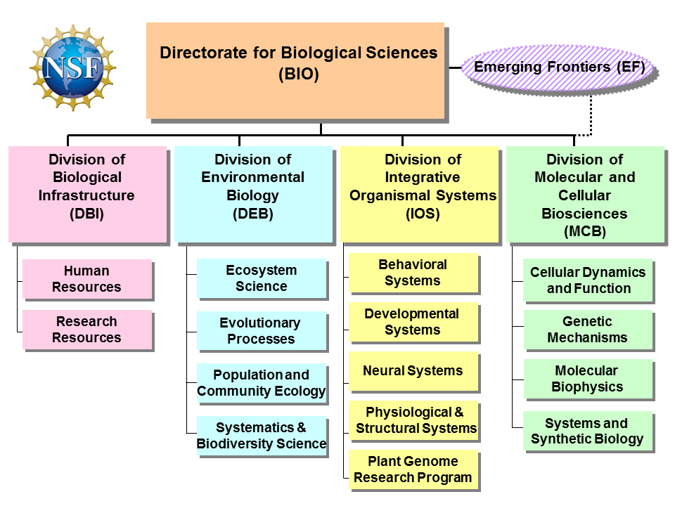
WHERE DOES YOUR SCIENCE FIT?
Notes:
Arranged by scale; about the questions not about your techniques or your identity

Slide 12

Where do I find information about What is BEING FUNDED?
www.nsf.gov

Slide 13
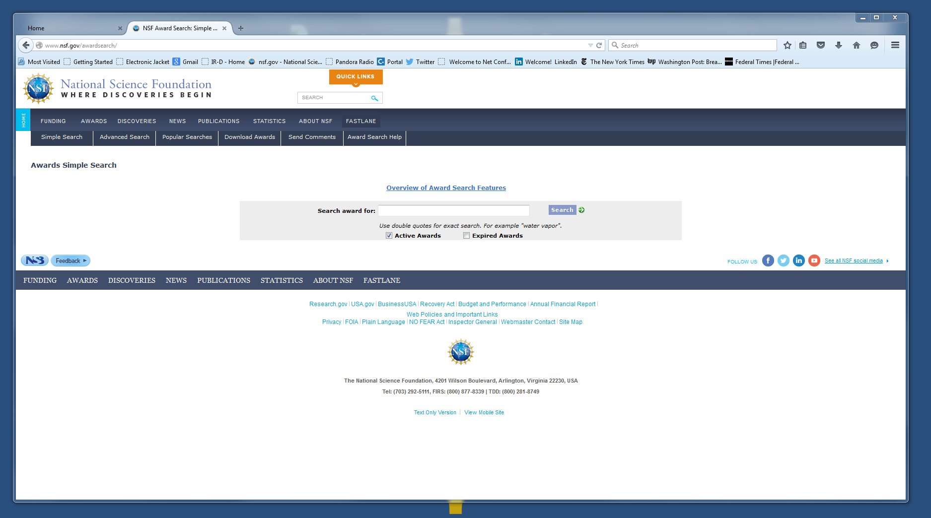

Slide 14
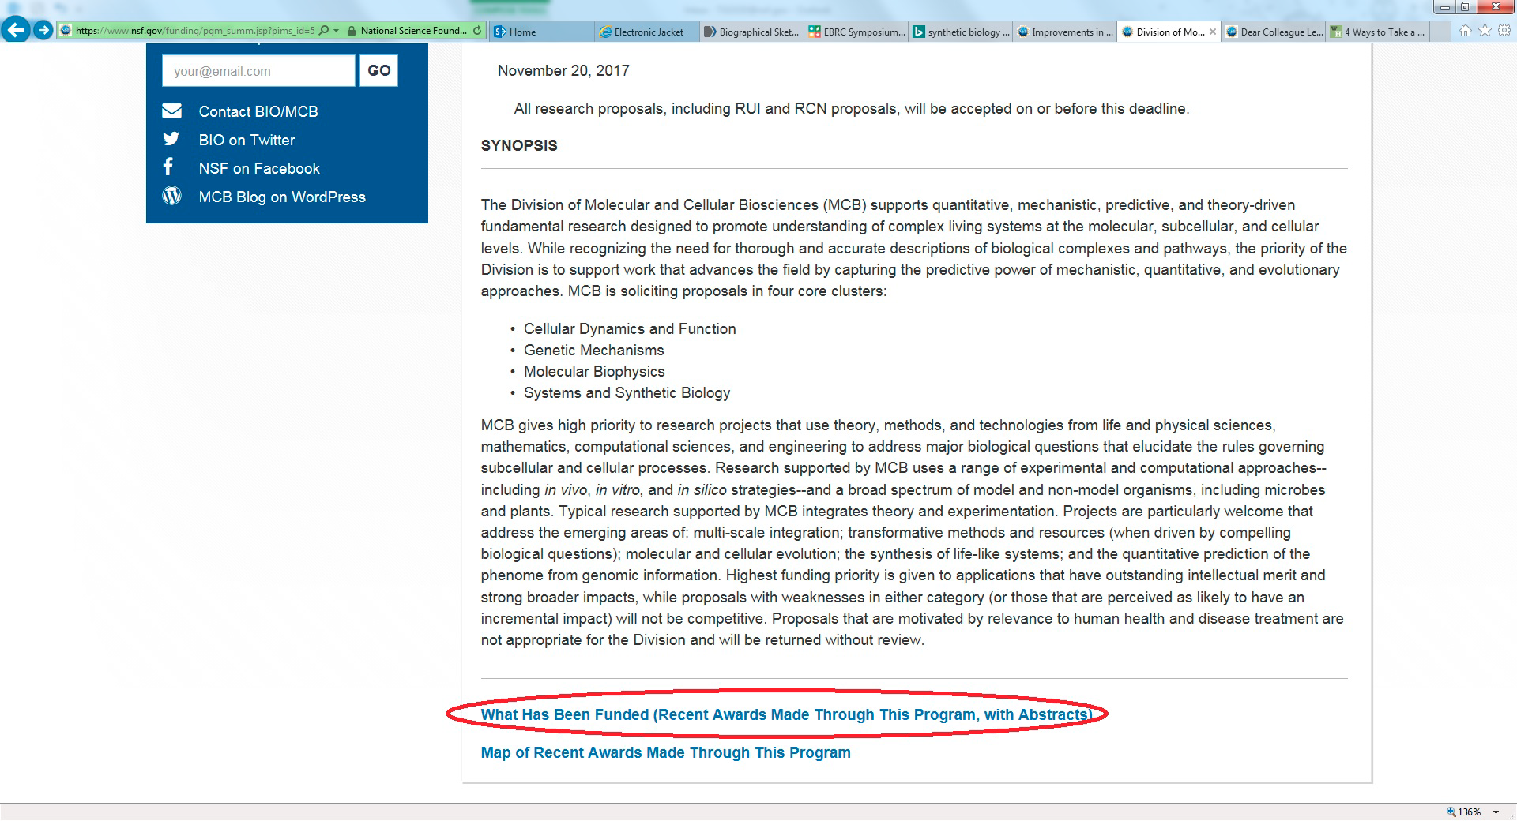

Slide 15
NOT SURE? ASK A PROGRAM DIRECTOR
COMMUNICATION IS AN IMPORATANT PART OF THE NSF CULTURE
  NSF Program Directors will be happy to talk with your US collaborator (lead) and you prior to submission
    US PIs should send email to Program Director to set up a time, cc collaborator
    Can Skype or WebEx or Call so all can be involved

Slide 16
NOT SURE? ASK A PROGRAM DIRECTOR
COMMUNICATION IS AN IMPORATANT PART OF THE NSF CULTURE
  NSF Program Directors will be happy to talk with your US collaborator (lead) and you prior to submission
    US PI should send email to Program Director to set up a time, cc collaborator
    Can Skype or WebEx or Call so all can be involved

Slide 17
Picking a U.S. collaborator
Previous NSF experience useful, but not required
May currently have NSF funding
  Programmatic considerations may affect likelihood of funding to someone who has NSF funding
No preference for established investigators – pick the best skills/expertise for the project not necessarily the biggest name.
Looking for a real collaboration! Commitment from US PI is important.
NSF has no preference for particular institutions; NSF funds all sizes and types.
Cannot submit the same proposal simultaneously to different NSF programs, or to other US Science agencies*
Programs within the Biology Directorate do not support biomedical research.
Lead PI must work at a US academic or non-profit institution (not at a federal lab).
Notes:
** except for Beginning Investigators

Slide 18
WHAT IS THE PROCESS?
Preliminary Proposals due in January
Invitations issued in May
Invited Full Proposals due in August
Accepts only Full Proposals
Due Date: November 20, 2017
Core Programs in DEB, IOS and MCB are considering going to full proposals, no deadline –Look for the Dear Colleague Letter!
2018
Notes:
Arranged by Scale
IN DEB- BSF collab w their core program, EEID and LTREB
IOS and MCB – core programs only – not PGRP

Slide 19
A strong Full Proposal….
…addresses an important question in the introduction AND maintains high enthusiasm for the proposed activities even after the full implementation plan is articulated in detail.

Slide 20
NSF review criteria align with strategic goals and mission
Strategic Goals
Transform the frontiers of science and engineering
Stimulate innovation and address societal needs through research and education
Review Criteria
Intellectual Merit
Broader Impact
NSF Mission (from 1950 Act)
To promote the progress of science; to advance the national health, prosperity, and welfare; and to secure the national defense; and for all other purposes.
Source: NSF Strategic Plan for 2014-2018; available at http://www.nsf.gov/pubs/2014/nsf14043/nsf14043.pdf

Slide 21
What is Intellectual Merit?
Quality of the science
  Does it answer an important question?
  Is it novel and exciting?
  Will it move the field forward?
  Is it well conceived and well planned?
      Experiments will, in fact, test the hypotheses
      Experimental design is feasible, with well thought out alternatives

Slide 22
What are Broader Impacts?
Integrated activities that:
Advances discovery while promoting teaching, training and learning
Broadens participation of underrepresented groups
Enhance infrastructure for research and education
Broadly disseminate findings
Benefit society
  Can include potential applied uses
http://www.nsf.gov/pubs/gpg/broaderimpacts.pdf
Not a checklist!

Slide 23
Examples of BROADER IMPACTS Activities
Education and training of undergraduates, graduate students and postdocs.
Partnerships with museums, nature centers, science centers, and similar institutions to develop exhibits in science, math, and engineering.
Citizen Science Activities - involve the public where possible, in research and education activities.
Give science and engineering presentations to the broader community (e.g., at museums and libraries, on radio shows, and in other such venues).
Participate in multi- and interdisciplinary conferences, workshops, and research activities
Integrate research with education activities
For more information visit the National Alliance for Broader Impacts at https://broaderimpacts.net/

Slide 24

What makes a proposal competitive?
A timely and compelling idea
Sound justification for the work
Testable hypothesis(es) with predictions, tests
Clear, succinct experimental design and realistic scope of work
Knowledge of subject area, pertinent literature
Sound scientific rationale and theoretical context
Experience in essential methodology
Preliminary data or record of publication
Clear management plan
Goals for future work
Written clearly and carefully proofread

Slide 25
Transformative Research
Is it transformative?
  “Transformative research involves ideas, discoveries, or tools that radically change our understanding of an important existing scientific or engineering concept or educational practice or leads to the creation of a new paradigm or field of science, engineering, or education. Such research challenges current understanding or provides pathways to new frontiers.”
A proposal does NOT have to be deemed potentially transformative to be funded, but should have strong potential for impact on the field

Slide 26
Who Evaluates Your Proposal?
Overview of Review Process
Program Director
Approves Panel Summary
Evaluates panel recommendations
Makes analysis & recommendation (award, decline)
Principal Investigator
Identify relevant NSF program
Develop proposal & load into NSF Fastlane
Get feedback before you submit
Review Panel
Composed of the Reviewers
Discuss Strengths/Weaknesses of Intellectual Merit & Broader Impacts
Assigned “Scribe” writes Panel Summary
Ranks your proposal
Program Director
Reads your proposal
Determines if it is relevant to program
Develops thematic Panels
Assigns your proposal to a Panel
Recruits the Panelists
Assigns reviewers to proposal based on interest & expertise of panelist
Individual Reviewers (at least 3)
Prepare written reviews based on NSF Criteria (Intellectual Merit, Broader Impacts)
Have expertise in subject of proposal
Faculty (mostly), Gov’t (sometimes)

Slide 27
How the panel Rates your Proposal
High Priority
  Strongest in both intellectual merit and broader impacts
  Most likely to contain transformative ideas
Low Priority
  Weaknesses in intellectual merit or broader impacts or both and/or
  Likely to have incremental impact
WOW!
Medium Priority
  Strong in both intellectual merit and broader impacts, but...
Non-competitive
  Seriously flawed in some fundamental way and/or
  Missing some crucial element or idea

Slide 28
RESULTS FOR DEB NSF-BSF proposals:
    2015
    25 Preproposals
    Submitted
    3 Invited for
    Full Proposal
    2 Funded Projects
    2016
    24 Preproposals
    Submitted
    10 Invited for
    Full Proposal
    4 Funded Projects
    Funding rate = 66%
    Funding rate = 40%

Slide 29
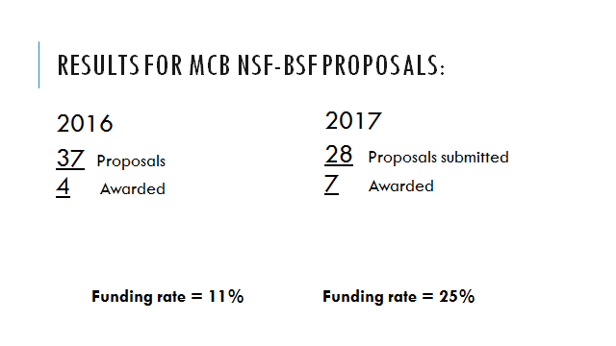

Slide 30
funding RATES ACROSS the Directorate for Biological Sciences
Division | Funding Rate | Actions | Awards
DBI | 28% | 510 | 144
DEB* | 23% | 1126 | 262
IOS* | 36% | 798 | 290
MCB | 16% | 1067 | 173
*These divisions have a two step process using preliminary proposals followed by invited full proposals
All of these data are for regular full proposals plus supplements, workshops and other kinds of awards
Notes:
Data from BIO website 8/12/15

Slide 31
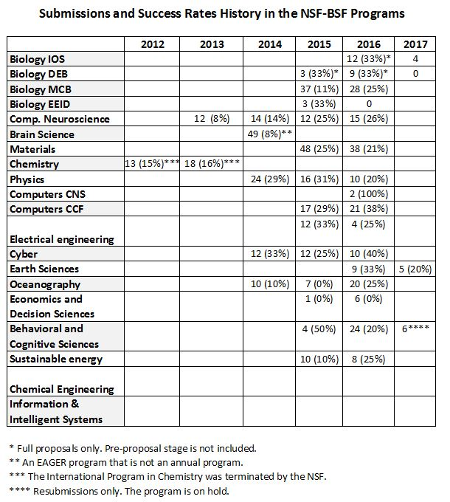
BSF Funding Rates
Notes:
Data from BIO website 8/12/15

Slide 32

Questions?
IOS: Michelle Elekonich
melekoni@nsf.gov or NSF-IOS-BSF@nsf.gov
http://www.nsf.gov/pubs/2015/nsf15090/nsf15090.jsp
MCB: Theresa Good
tgood@nsf.gov
http://www.nsf.gov/pubs/2015/nsf15105/nsf15105.jsp
DEB: Rachel Roberts
NSFDEB-BSF@nsf.gov
http://www.nsf.gov/pubs/2014/nsf14094/nsf14094.jsp

Slide 33
Bio Blogs
https://nsfbiobuzz.wordpress.com/
https://nsfdeb.wordpress.com/
https://nsfiosinfocus.wordpress.com/
https://nsfmcb.wordpress.com/

Slide 34
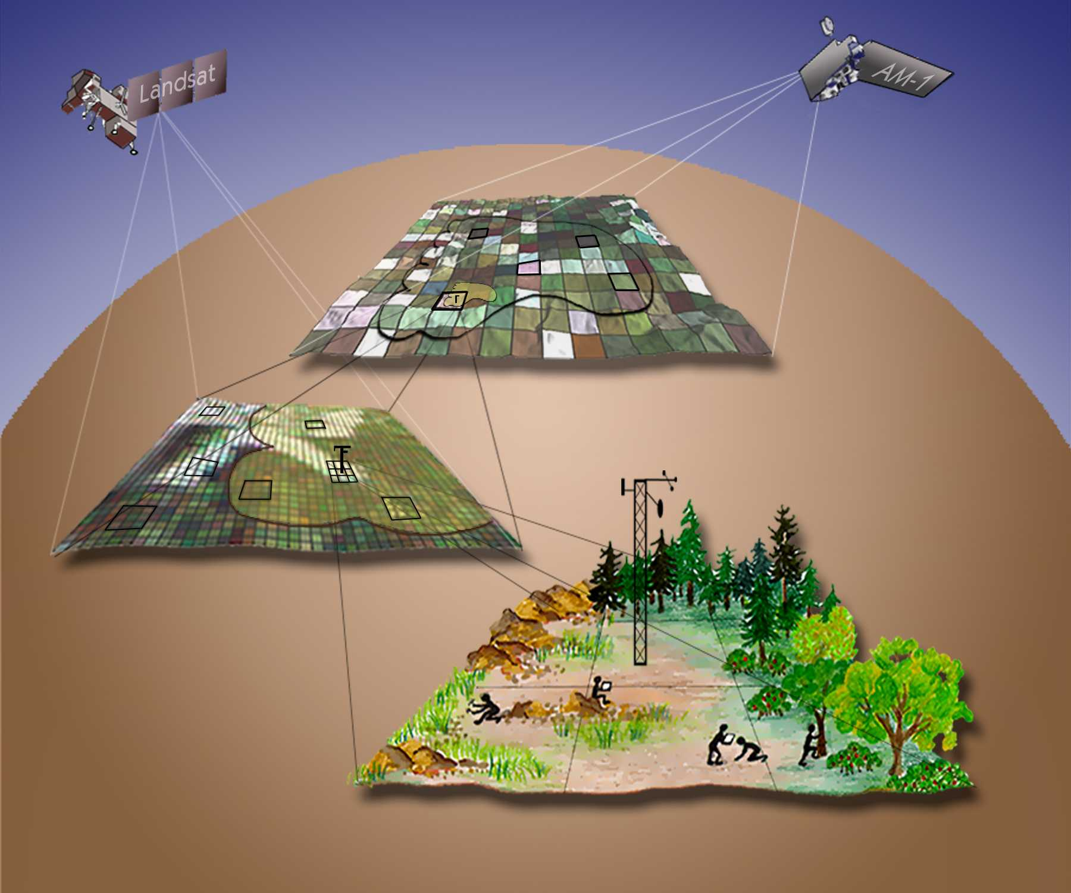
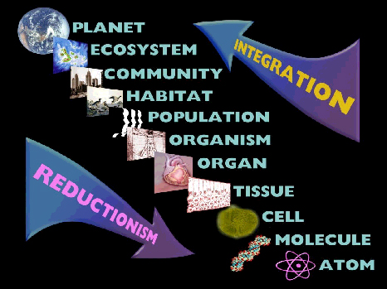

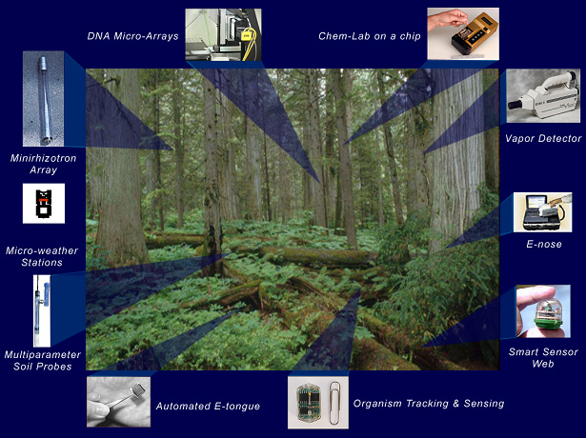



National Ecological Observatory Network (NEON)
NEON
Notes:
• NEON represents a new way of approaching ecosystem science
– Regional to continental scale
• Break down barriers to progress
– Provide timely data and promote a predictive
understanding of the environment
• Increase interdisciplinary interactions and link diverse institutions
– Engineering and Technology—wireless sensor networks
– Information management—“Ecoinformatics”
– Statistics and Mathematics—Forecasting and
modeling environmental change
• Science needed to manage natural resources
– Resource managers to be integrally involved
• Education and Public Outreach

Slide 35

NSF Needs You!
Program Officers
Division Directors
Advisory Panelists
Ad hoc Reviewers

